Slide 1
Machine Learning Clustering

Slide 2
Affinity Propagation
Affinity Propagation is a clustering algorithm used to cluster data points into multiple groups based on their similarity.

Slide 3
Advantages and Disadvantages:
Advantages:
Well-suited for large datasets and streaming data.
Can efficiently handle data that doesn't fit into memory.
Provides a hierarchical representation of the data.
Disadvantages:
Sensitive to the order of data points, as it processes them sequentially.
The choice of parameters, such as the branching factor and the threshold values for merging and splitting, can affect results.

Slide 4
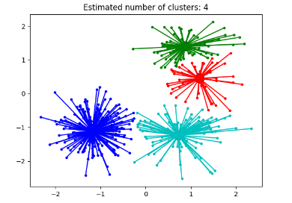

Slide 5
BIRCH
BIRCH (balanced iterative reducing and clustering using hierarchies) is an unsupervised data mining algorithm that performs hierarchical clustering over large data sets. With modifications, it can also be used to accelerate k-means clustering and Gaussian mixture modeling with the expectation-maximization algorithm.

Slide 6
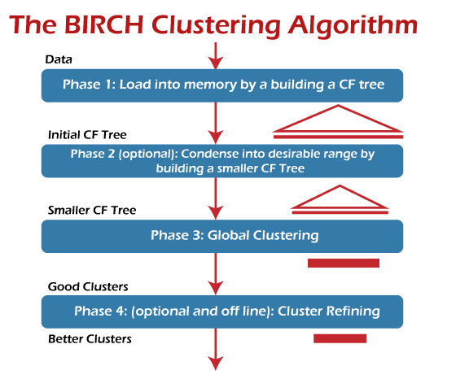

Slide 7
Advantages of BIRCH:
It is local in that each clustering decision is made without scanning all data points and existing clusters. It exploits the observation that the data space is not usually uniformly occupied, and not every data point is equally important.

Slide 8
DBSCAN
It is a density-based clustering non-parametric algorithm: given a set of points in some space, it groups together points that are closely packed together (points with many nearby neighbors), marking as outliers points that lie alone in low-density regions (whose nearest neighbors are too far away).

Slide 9
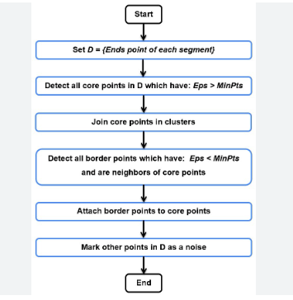

Slide 10
Mean Shift
Mean Shift is an unsupervised clustering algorithm that aims to discover blobs in a smooth density of samples. It is a centroid-based algorithm that works by updating candidates for centroids to be the mean of the points within a given region (also called bandwidth).

Slide 11
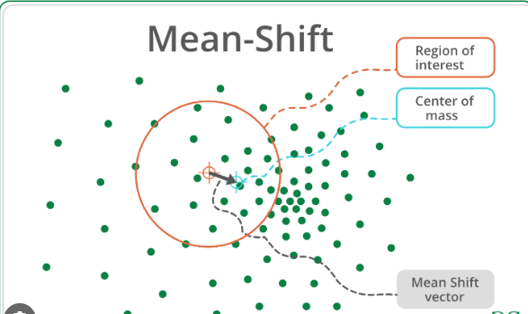

Slide 12
Spectral
Spectral clustering helps us overcome two major problems in clustering: one being the shape of the cluster and the other is determining the cluster centroid. K-means algorithm generally assumes that the clusters are spherical or round i.e. within k-radius from the cluster centroid.

Slide 13
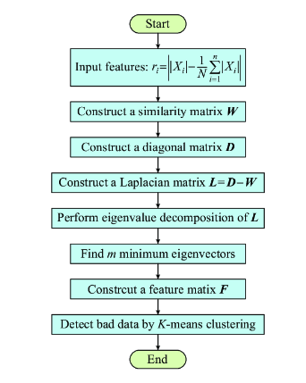

Slide 14
OPTICS
Ordering points to identify the clustering structure (OPTICS) is an algorithm for finding density-based clusters in spatial data

Slide 15
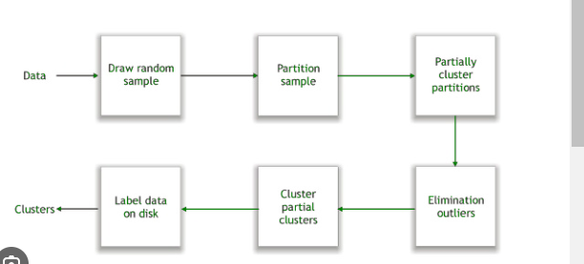

Slide 16
Hierarchical-Agglomerative
Hierarchical clustering algorithms group similar objects into groups called clusters. There are two types of hierarchical clustering algorithms

Slide 17
